Slide 1

Diabetes Readmission Exploration
Thomas George Thomas

Slide 2
INTRODUCTION
The dataset covers ten years of clinical care at 130 US hospitals and integrated delivery networks (1999-2008).
It has about 50 attributes that indicate patient and hospital outcomes

Slide 3
CRITERIA
It is an inpatient visit (a hospital stay).
It is a diabetic encounter, which means that any type of diabetes was placed into the system as a diagnosis.
The length of stay was at least one day and no more than fourteen days.
During the meeting, laboratory tests were performed.
Medication was given during the encounter.

Slide 4
FOCUS
Analyze factors related to their readmission as well as other outcomes.
Investigate, using analytical questions, how various circumstances may or may not have influenced diabetic patients to get admitted.

Slide 5
DATA DESCRIPTION
Attribute Name | Description
encounter_id | Unique identifier of an encounter
patient_nbr | Unique identifier of a patient
race | Values: Caucasian, Asian, African American, Hispanic, and other
gender | Values: male, female, and unknown/invalid
age | Grouped in 10-year intervals: [0, 10), [10, 20),..., [90, 100)
weight | Weight in pounds.

Slide 6
admission_type_id | Integer identifier corresponding to 9 distinct values, for example, emergency, urgent, elective, newborn, and not available
discharge_disposition_id | Integer identifier corresponding to 29 distinct values, for example, discharged to home, expired, and not available
admission_source_id | Integer identifier corresponding to 21 distinct values, for example, physician referral, emergency room, and transfer from a hospital
time_in_hospital | Integer number of days between admission and discharge
payer_code | Integer identifier corresponding to 23 distinct values, for example, Blue Cross/Blue Shield, Medicare, and self-pay
medical_specialty | Integer identifier of a specialty of the admitting physician, corresponding to 84 distinct values, for example, cardiology, internal medicine, family/general practice, and surgeon

Slide 7
num_lab_procedures | Number of lab tests performed during the encounter
num_procedures | Number of procedures (other than lab tests) performed during the encounter
num_medications | Number of distinct generic names administered during the encounter
number_outpatient | Number of outpatient visits of the patient in the year preceding the encounter
number_emergency | Number of emergency visits of the patient in the year preceding the encounter
number_inpatient | Number of inpatient visits of the patient in the year preceding the encounter

Slide 8
diag_1 | The primary diagnosis (coded as first three digits of ICD9); 848 distinct values
diag_2 | Secondary diagnosis (coded as first three digits of ICD9); 923 distinct values
diag_3 | Additional secondary diagnosis (coded as first three digits of ICD9); 954 distinct values
number_diagnoses | Number of diagnoses entered to the system
max_glu_serum | Indicates the range of the result or if the test was not taken. Values: >200, >300, normal, and none if not measured
A1Cresult | Indicates the range of the result or if the test was not taken. Values: >8 if the result was greater than 8%, >7 if the result was greater than 7% but less than 8%, normal if the result was less than 7%, and none if not measured.

Slide 9
Single Medication |  | Combination of Medications
metformin | pioglitazone | glyburide.metformin
repaglinide | rosiglitazone | glipizide.metformin
nateglinide | acarbose | glimepiride.pioglitazone
chlorpropamide | miglitol | metformin.rosiglitazone
glimepiride | troglitazone | metformin.pioglitazone
acetohexamide | tolazamide
glipizide | examide
glyburide | citoglipton
tolbutamide | insulin
These feature indicates whether the drug was prescribed or there was a change in the dosage. Values:
Up: if the dosage was increased during the encounter
Down: if the dosage was decreased
Steady: if the dosage did not change, and no if the drug was not prescribed

Slide 10
change | Indicates if there was a change in diabetic medications (either dosage or generic name). Values: change and no change
diabetesMed | Indicates if there was any diabetic medication prescribed. Values: yes and no
readmitted | Days to inpatient readmission. Values: <30 if the patient was readmitted in less than 30 days, >30 if the patient was readmitted in more than 30 days, and No for no record of readmission.

Slide 11
DATA SOURCES
There are two files:
Diabetic_data
Contains data about diabetic patients including readmission status, medicines and their combination and their IDS
IDs_Mapping
Contains description relevant to the IDs present in the Diabetic_data fle

Slide 12
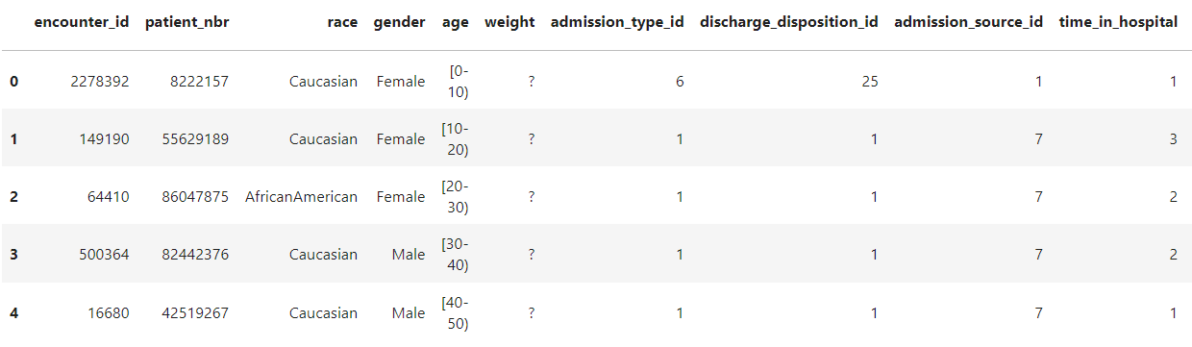
DIABETIC DATA EXAMPLE

Slide 13
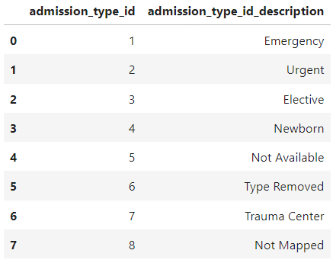
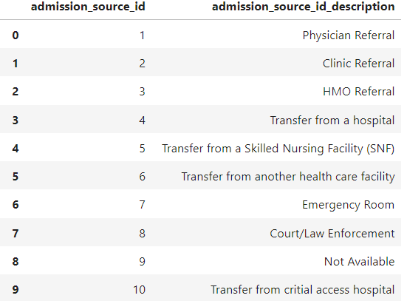
IDS MAPPING EXAMPLE

Slide 14
DATA EXPLORATORY ANALYSIS
There are 101766 rows and 50 columns
The data types of columns are either object or int64
There are many IDs in the data, and they should be merged with their respective data descriptions to add value to the data
There were no null values in the initial analysis.
It was found that null values were encoded as “?”

Slide 15
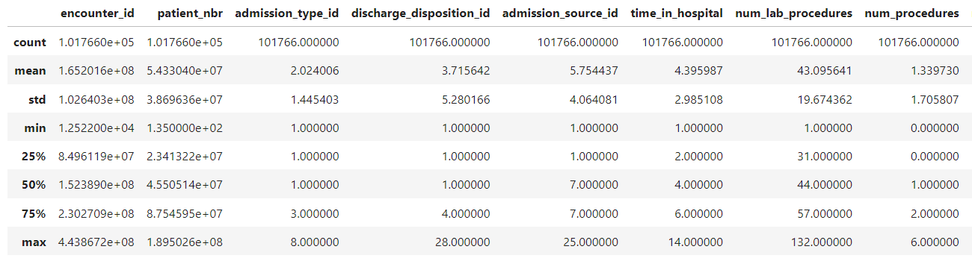
STATISTICAL INFORMATION

Slide 16
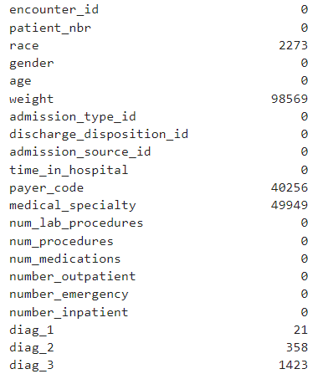
DATA PREPROCESSING
The diabetic data is merged with the IDS mapping document.
This enriches the value of the diabetic data and helps make sense of it
On this merged data, after replacing “?” with np.Nan
The null checks look like this

Slide 17

FEATURE ENGINEERING
As we can see a few of the features like race, weight, payer_code, medical_speciality, diag_1, diag_2 and diag_3 have nulls
We remove weight and payer_code since they aren't relevant to the outcome, and they have too many nulls

Slide 18
CORRELATION

Slide 19
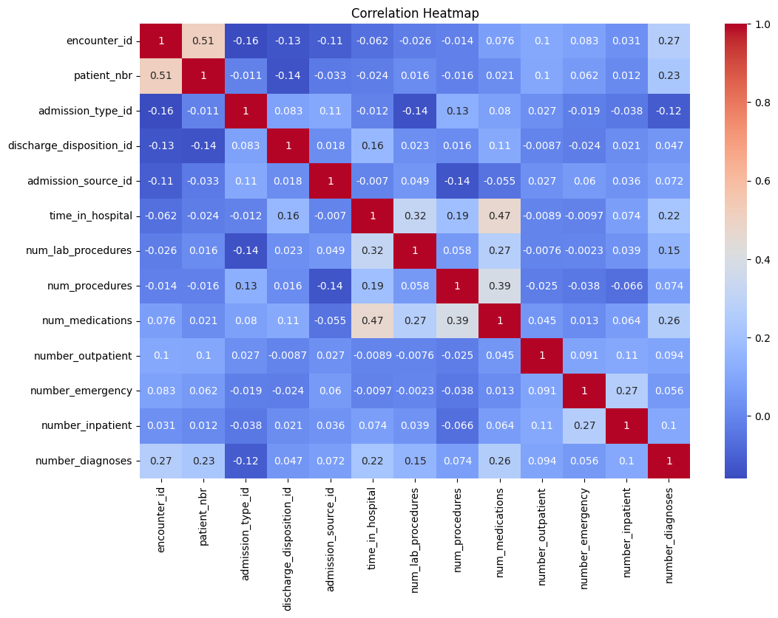

Slide 20

STRONG CORRELATIONS
Number of medications and time in hospital
Encounter id and patient number

Slide 21
WEAK CORRELATIONS
Admission type id and encounter id
Number of procedures and admission source id
Number of Lab procedures and admission source id

Slide 22

ANALYTICAL QUESTIONS
Questions solved using functions we define (such as lambda-map) functions

Slide 23

Function that calculates the average number of outpatient visits for patients with a specific diagnosis ('diag_1', 'diag_2', or 'diag_3').
Diagnosis code 428 stands for Congestive Heart Failure
The average number of outpatient visits for patients with diagnosis_code 428 is 0.44.

Slide 24
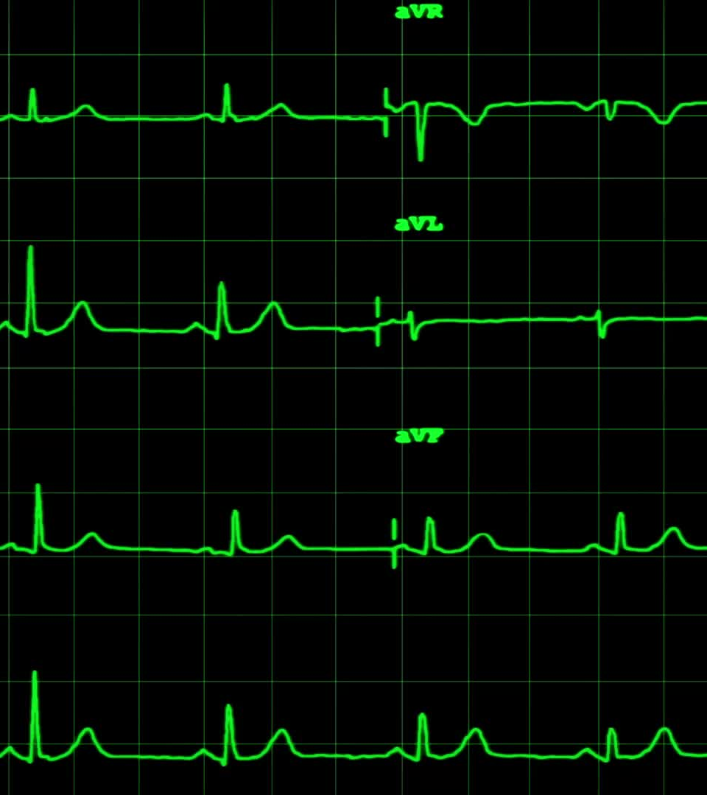
Function to calculate the average number of outpatients of male and female patients separately
The average number of outpatients of male and females
{'Female': 0.38, 'Male': 0.35}

Slide 25
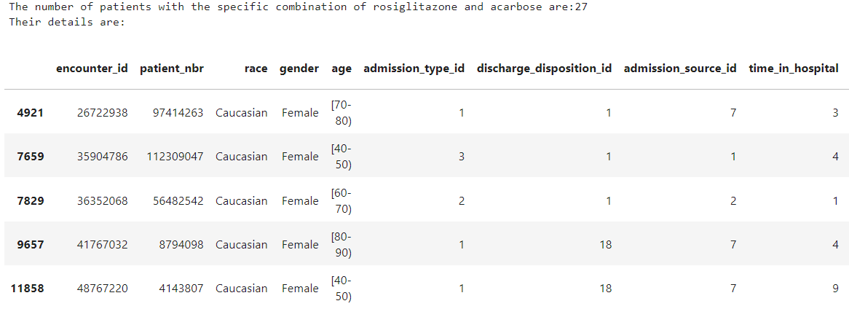
Create a function to identify patients who had a specific medication combination, such as 'rosiglitazone' and 'acarbose'.

Slide 26

Design a function to calculate the percentage of patients who were readmitted within 30 days of their previous hospitalization
The percentage of patients who were readmitted within 30 days of their previous hospitalization: 11.16%

Slide 27

Create a function that calculates the average number of lab procedures per patient
Average number of lab procedures per patient is 43.10

Slide 28

Numpy and Pandas

Slide 29

Median length of stay for diabetic patients
The median length of stay for diabetic patients are 4.0 days

Slide 30
Calculate the percentage of male and female patients in the dataset
The percentage of Male patients: 46.24 %
The percentage of Female patients: 53.76 %

Slide 31

Determine the most common race/ethnicity among diabetic patients
The most common race/ethnicity among diabetic patients is Caucasian with the number of patients being : 76,099

Slide 32
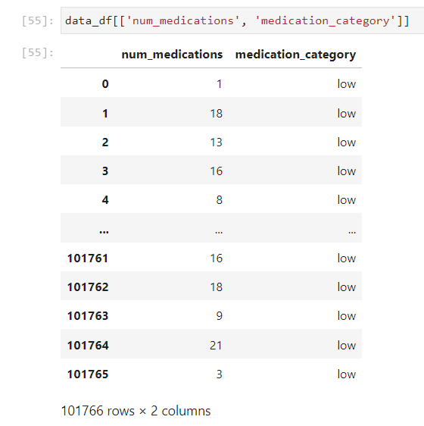
Create a new column that categorizes patients based on the number of medications they are taking.
Create categories like 'Low', 'Medium', and 'High' based on the 'num_medications' column.

Slide 33
Find the average number of lab procedures for patients who underwent surgery and those who didn't
Had surgery: 43.24
Didn't have surgery : 42.93

Slide 34

Visualizations using Seaborn and Matplotlib

Slide 35
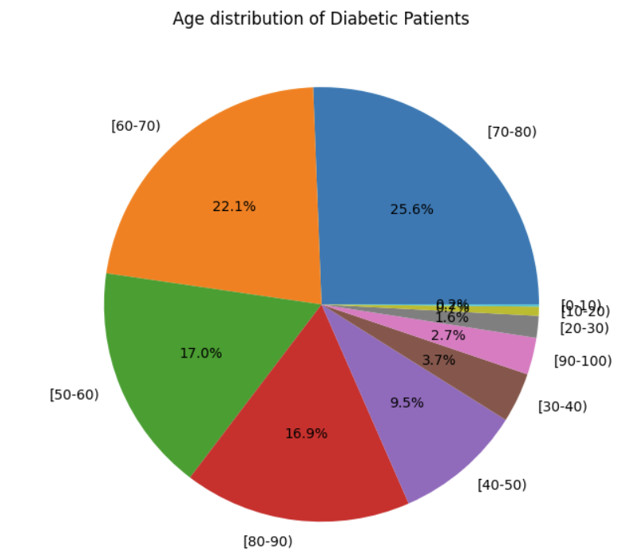
Visualize the distribution of age groups

Slide 36
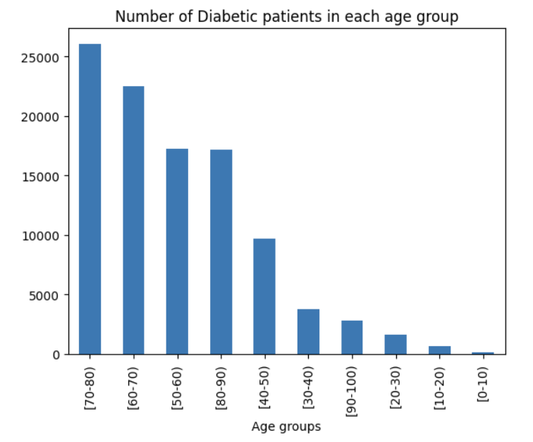
Bar plot to show the count of patients in each age group

Slide 37
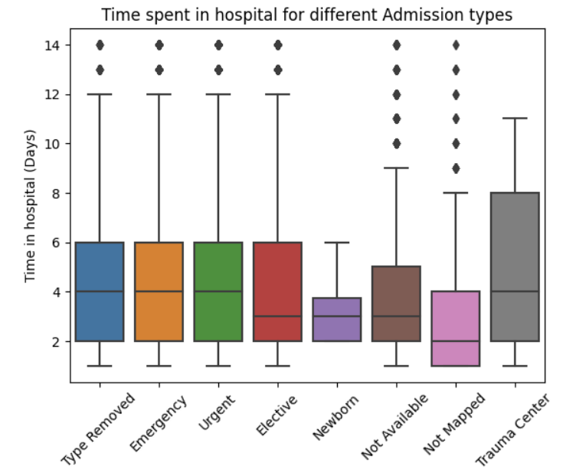
Compare the time spent in the hospital for different admission types

Slide 38
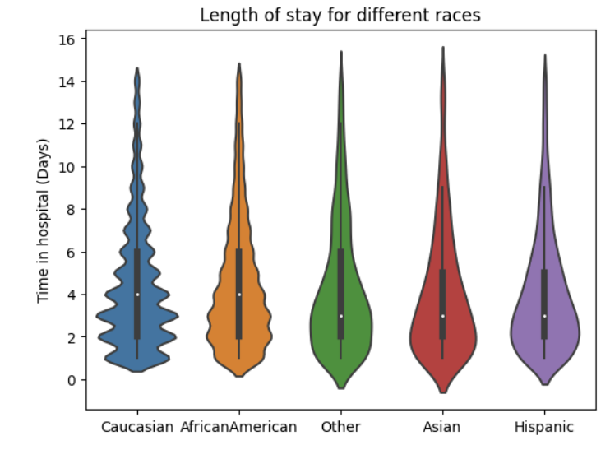
Compare the length of stay for different races
The curve around Asian, Hispanic and Other races have a symmetric curve suggesting that the data is roughly normally distributed or balanced
Meanwhile, African American has a slight skewness in their data
Lastly, Caucasian is highly skewed

Slide 39
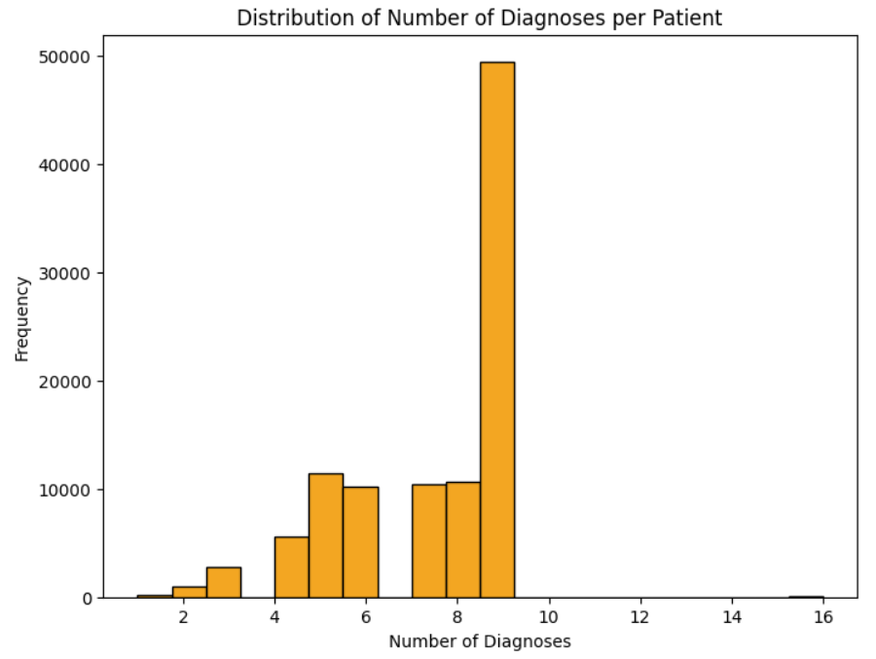
Histogram to visualize the distribution of the number of diagnoses per patient

Slide 40

Questions revealing valuable insights

Slide 41
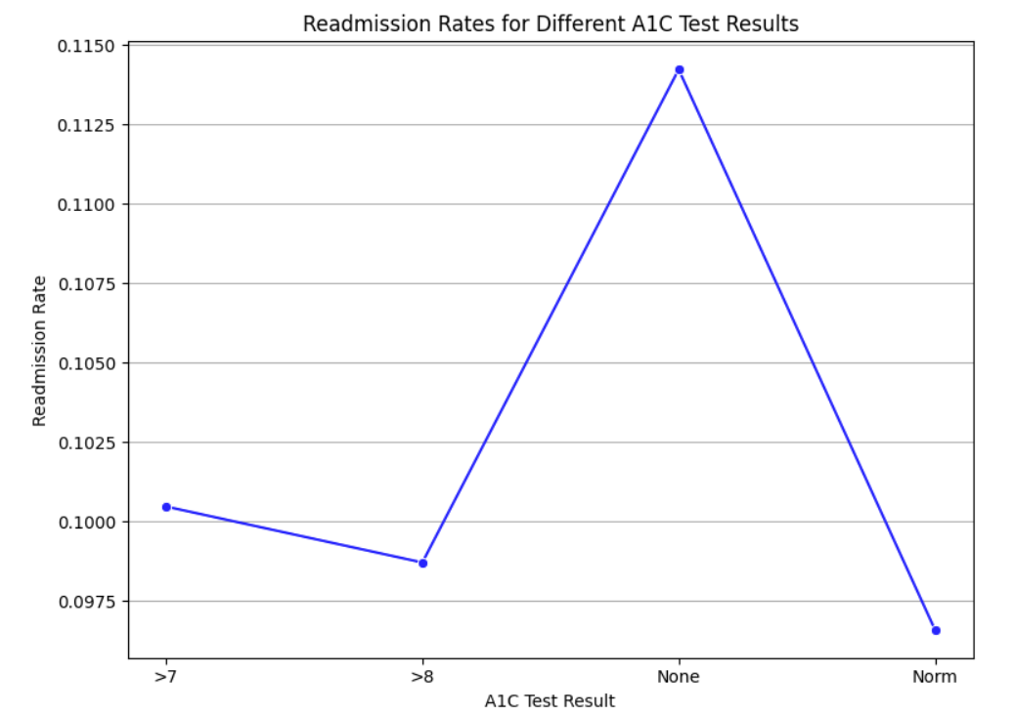
Explore the readmission rates for patients with different A1C test results to identify any correlations
The highest readmission rate for patients didn’t have their A1C Tests done
>7 A1C level patients were more in comparison to >8

Slide 42
Analyze the average number of procedures for patients who were readmitted within 30 days compared to those who were not.
Were readmitted is 1.28
Not readmitted is 1.35

Slide 43

Determine the most common medical specialty for patients who had a length of stay greater than the median length of stay.
The most common medical specialty for patients who had a length of stay greater than the median length of stay: Internal Medicine

Slide 44
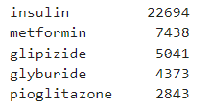
What are the most common medications prescribed for patients who had a length of stay greater than the median length of stay?

Slide 45
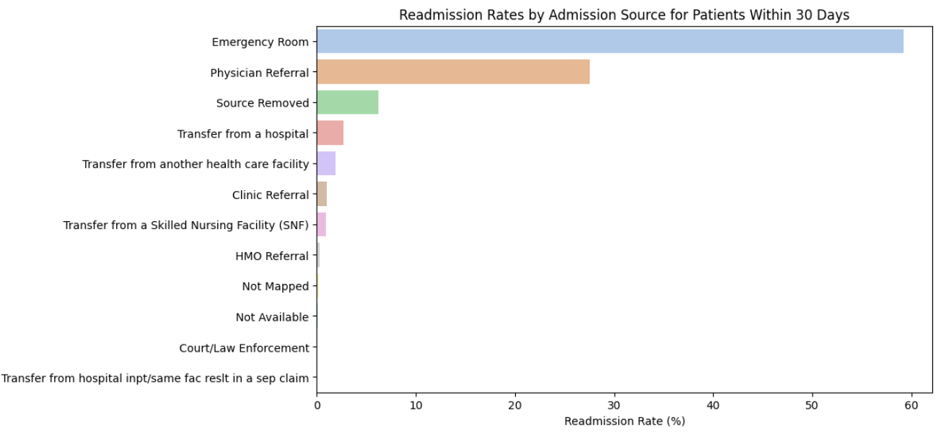
Are there any patterns in the admission sources for patients who were readmitted within 30 days? Do certain admission sources have a higher readmission rate than others?

Slide 46

Other Insightful Questions

Slide 47

Calculate the percentage of patients who had been admitted at least once, both as an inpatient and an outpatient in the prior year
The percentage of patients who were both inpatient and outpatient greater is 8.05 %

Slide 48
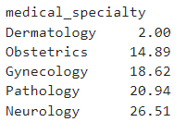
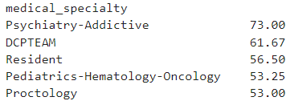
Determine the highest & lowest 5 average number of lab procedures for medical specialties
The 5 medical specialties with the lowest average number of lab procedures are:
The 5 medical specialties with the highest average number of lab procedures are:

Slide 49
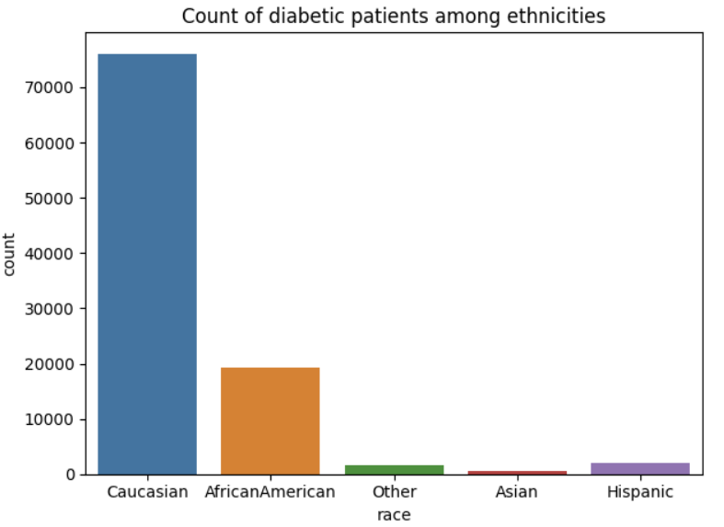
Visualize patients from each race/ethnicity group

Slide 50
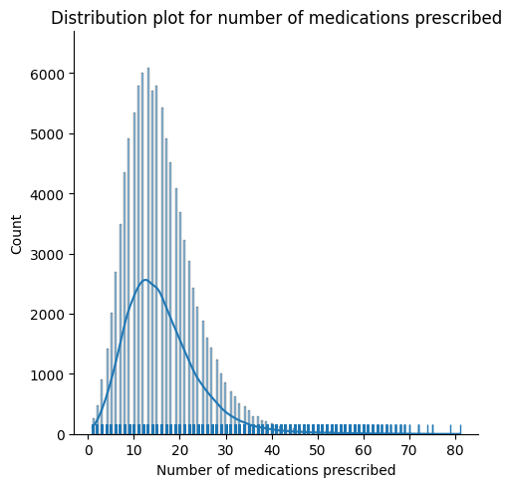
Visualize using distribution plot the number of medications prescribed
Central tendency is around 15 medications
Data is heavily right skewed
There are a lot of data points with extreme values as seen in the tail of the graph

Slide 51
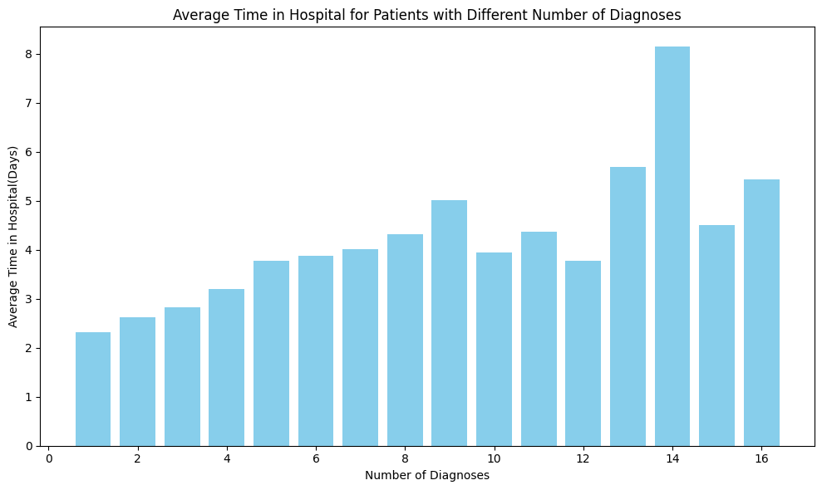
Find the average time in the hospital for patients on number of diagnoses

Slide 52
REFERENCES
https://archive.ics.uci.edu/dataset/296/diabetes+130-us+hospitals+for+years+1999-2008
Beata Strack, Jonathan P. DeShazo, Chris Gennings, Juan L. Olmo, Sebastian Ventura, Krzysztof J. Cios, and John N. Clore, “Impact of HbA1c Measurement on Hospital Readmission Rates: Analysis of 70,000 Clinical Database Patient Records,” BioMed Research International, vol. 2014, Article ID 781670, 11 pages, 2014.

